Slide 1


FAST: a Transducer Based Language for Manipulating Trees
Presented By:
Loris D’Antoni
Joint work with:
Margus Veanes, Ben Livshits, David Molnar

Slide 2
Motivation
Trees are common input/output data structures
  XML query, type-checking, etc…
  Compilers/optimizers (from parse tree to parse tree)
  Tree manipulating programs: data structures algorithms, ontologies, etc…

Slide 3
HTML Sanitization
Removing malicious active code from HTML documents is a tree transformation
body
body
script
div
SANITIZE
div
malicious
code
p
p
“Today I’m happy”
“Today I’m happy”

Slide 4
What do we Need?
We want to write these single transformations separately to avoid errors
  Remove bad elements (scripts…)
  Remove malicious URLs
  Replace deprecated tags

Slide 5
Interesting Properties
Composition:
T(x) = T₂(T₁(x))
Type-checking:
given two languages I,O
T(I) is always in O
Pre-image: compute the input that produces a particular output
To achieve speed
Check if the sanitizer ever produces a malicious output
Produce counterexamples if type-checking fails
DEMO: http://rise4fun.com/Fast/jN

Slide 6
FAST Compiler
SMT solver
FAST code
C#
Transducers
Analysis
and
optimization

Slide 7
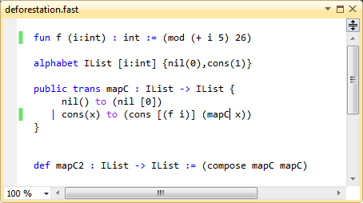
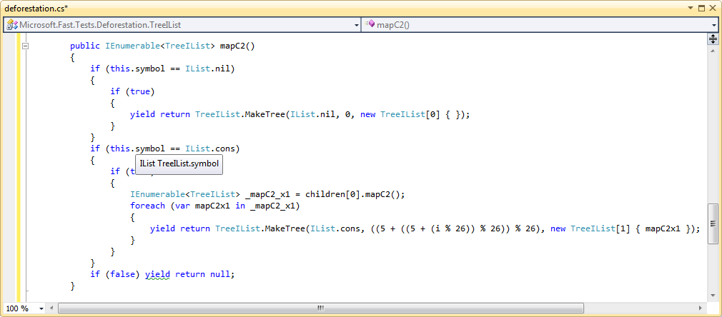
Stages by Example
Transducers
mapC
mapC2

Slide 8
Choosing the right formalism

Slide 9
Semantics as Transducers
Goal:
find a decidable class
of tree transducers
that can express the previous examples

Slide 10
Top Down Tree Transducers [Engelfriet75]
q(a(x₁,x₂)) → b(c,q₁(x₁))
Decidable properties: type-checking, etc…
Domain expressiveness: only finite alphabets
q
a
b
c
q₁
x₁
x₂
x₁

Slide 11
Symbolic Tree Transducers [PSI11]
q(λa.a>3,(x₁,x₂)) → λa.a+1,(λa.a-2,q₁(x₁))
Decidable properties: type-checking, etc…
Domain expressiveness: infinite alphabets using predicates and functions
Structural expressiveness: can’t delete a node without reading it first
q
5
5+1
Such that
5>3 is true
5-2
q₁
x₁
x₂
x₁
Alphabet theory has to be DECIDABLE
We’ll use Z3 to check predicate satisfiability

Slide 12
Improving structural expressiveness
Transformation: delete the left child if its root greater than 5
If we delete the node we can’t check that the left child was actually greater than 5
q
1
1
??
2
3
q
3
Regular Look-Ahead (RLA)

Slide 13
Regular Look Ahead (TOP^{R})
Transformation: delete a node if its left child is greater than 5
Rules can ask whether the children are in particular languages
  p₁: the language of trees whose root is greater than 5
  p₂: the language of all trees
Decidable properties: type-checking, etc…
Domain expressiveness: infinite alphabets
Structural expressiveness: good enough to express our examples
q
1
1
p₁
p₂
Transformation now is safe
7
3
q
3

Slide 14
 | Decidability | Complexity | Structural Expressiveness | Infinite alphabets
Top Down Tree Transducers [Engelfriet75] | V | V | X | X
Top Down Tree Transducers with Regular Look-ahead [Engelfriet76] | V | V | ~ | X
Streaming Tree Transducers [AlurDantoni12] | V | X | V | X
Data Automata [Bojanczyk98] | ~ | X | X | V
Symbolic Tree Transducers [VeanesBjoerner11] | V | V | X | V
Symbolic Tree Transducers RLA | V | V | ~ | V

Slide 15
Composition of symbolic transducers with regular lookahead

Slide 16
Composition of STT^{R}
This is not always possible!!
Find the biggest class for which it is possible
T₁
T₁ o T₂
T₂

Slide 17
Classes of STT^{R}
DETERMINISTIC: at most one transducer rule applies for each input tree
LINEAR: each child appear at most once in the right hand side of each rule
x+1
q₁
q₂
q
x
linear
x+1
nonlinear
q₁
q₂

Slide 18
When can we Compose?
Theorem: T(x) = T₂(T₁(x))
definable by a Symbolic Tree Transducers with RLA if
  T₁ is deterministic, OR
  T₂ is linear
All our examples fall in this category
Alphabet theory has to be DECIDABLE
We’ll use Z3 to check predicate satisfiability

Slide 19
Pre-image as Composition
O
?
T
Domain(T o O)

Slide 20
FAST: Decidable by Design
Composition
Type-checking
Pre-image
Symbolic Tree Transducers with RLA
SMT Solver for Alphabet Theory

Slide 21
Case studies and experiments

Slide 22
Case Studies and Experiments
Program Optimization:
Deforestation of functional programs
Verification:
HTML sanitization
Analysis of functional programs
Augmented reality app store
Infinite
Alphabets:
Integer
Data types

Slide 23
Deforestation
Removing intermediate data structures from programs
ADVANTAGE: the program is a single transducer reads the input list only once, thanks to transducers composition
alphabet ILIst [i : int] { nil(0), cons(1) }
trans mapC: IList→ IList {
  nil() to nil [0]
  | cons(x) to cons [(i+5)%26] (mapC x)
}
def mapC²: IList→ IList := compose mapC mapC

Slide 24
Deforestation: Speedup
f(f(f(…f(x)...)
(f;f;f;…;f)(x)

Slide 25
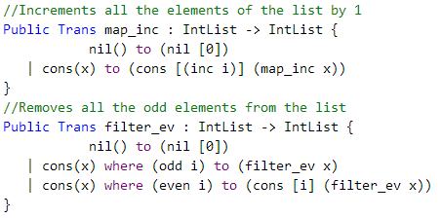
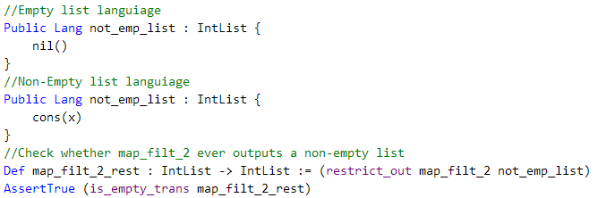
Analysis of Functional Programs

Slide 26
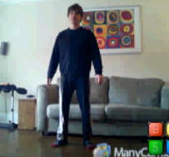
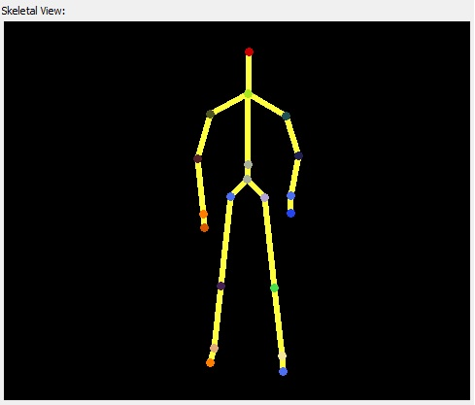
AR Interference Analysis
Recognizers output data that can be seen as a tree structure
Spine
Hip
Neck
….
Knee
Head
….
Ankle
Foot

Slide 27

Apps as Tree Transformations
Applications that use recognizers can be modeled as FAST programs
  trans addHat: STree -> STree
  Spine(x,y) to Spine(addHat(x), y)
  | Neck(h,l,r) to Neck(addHat(h), l, r)
  | Head(a) to Head(Hat(a))
Notes:
27

Slide 28
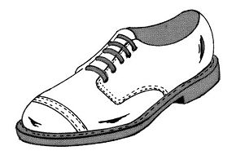
Composition of Programs
Two FAST programs can be composed into a single FAST program
p₁
p₁;p₂
p₂

Slide 29
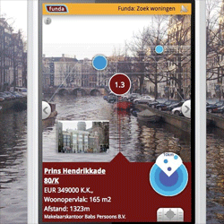
Interference analysis
Apps can be malicious: try to overwrite outputs of other apps
Apps interfere when they annotate the same node of a recognizer’s output
We can compose them and check if they interfere statically!!
  Put checker in the AppStore and analyze Apps before approval
Interfering apps
Add cat ears | Add hat
Add pin to a city | Blur a city
Amazon Buy Now button | Malicious Buy Now button

Slide 30
Interference Analysis in Practice
100 generated FAST programs, up to 85 functions each
Check statically if they conflict pairwise for ANY possible input
Checked 99% of program pair in less than 0.5 sec!
For an App store these are perfectly fine

Slide 31
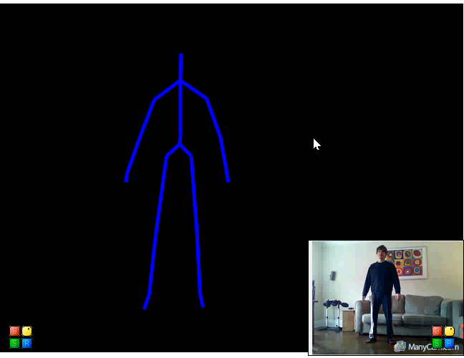
No Cheap Talk

Slide 32
Conclusion
FAST: a versatile language for tree manipulating programs with decidable analysis
Symbolic tree transducers with RLA
FAST is online: http://rise4fun.com/Fast/

Slide 33
 | Decidability | Complexity | Structural Expressiveness | Infinite alphabets
Top Down Tree Transducers [Engelfriet75] | V | V | X | X
Top Down Tree Transducers with Regular Look-ahead [Engelfriet76] | V | V | ~ | X
Streaming Tree Transducers [AlurDantoni12] | V | X | V | X
Data Automata [Bojanczyk98] | ~ | X | X | V
Symbolic Tree Transducers [VeanesBjoerner11] | V | V | X | V

